Slide 2

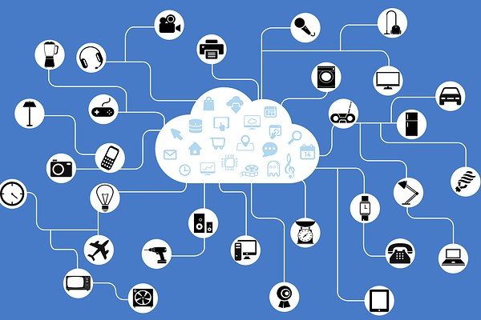

Threat Maps
Real-time or near real-time map
Visualization of threats
Data from multiple sources
Notes:
Various attack happening around the globe

Slide 3

Threat Feeds
Real-time data streams
Information
Threats
Risks

Slide 4
Threat Feed Information
Domain Reputation
Known malware
IP Addresses
Notes:
Domains with poor reputation
+ Known Malware
+ IP addresses known for malicious activity
+ Machine readable data that can be feed into security information and event management \(SIEM systems\).

Slide 5
Indicators of Compromise
Pieces of data
Identify malicious activity
Data that can be feed to SIEMs
STIX and TAXII
Notes:
FireEye - Redline \(free IoC monitoring tools\) https://www.fireeye.com/services/freeware/redline.

Slide 6
Automated Indicator Sharing
Exchange cyber threat indicators
Federal government
SLTT governments
Private Sector
Notes:
Automated Indicator Sharing (AIS) enables the exchange of cyber threat indicators between the Federal Government, SLTT(State, Local, Tribal and Territorial) governments, and the private sector at machine speed.

Slide 7
Threat Feed Examples
Department of Homeland Security (DHS)
Federal Bureau of Investigation (FBI)
SysAdmin, Audit, Network, and Security (SANS)
Notes:
Cisco's Talos Intelligence: https://talosintelligence.com/
DHS AIS - https://www.cisa.gov/automated-indicator-sharing-ais
FBI's Infragard.org - https://www.infragard.org/
SANS Internet Storm - https://isc.sans.edu/

